Slide 1

E-LEARNING SYSTEM
-Mentor :Sanjeeva Gone
Team 1:
Akshay Alave.
Amirtha Lakshmi.
Arpita
Suprajaa

Slide 2

INTRODUCTION
The E-Learning System is an online platform designed to provide convenient and flexible learning opportunities.
It allows users, such as students, working professionals, and job seekers, to access courses, manage their learning schedules, and track their progress, all from a single, user-friendly interface.
The E-Learning System includes secure user accounts, course management, booking and scheduling, progress tracking, and automated notifications.

Slide 3

OBJECTIVES
Ease of Access and Security
Comprehensive Course Management
Flexible Scheduling and Booking
Effective Learning Progress Tracking
Timely Notifications and Reminders

Slide 4






METHADOLOGY
TECH STACK USED
Agile Development: Daily stand-up meetings to track progress and resolve issues quickly.
Code Reviews: Frequent reviews to ensure quality and teamwork.
Feature Discussions: Regular sessions to refine features, improve design, and address challenges.

Slide 5
PROJECT PLANNING AND SETUP SOFTWARE TOOLS
1
USER REGISTRATION AND LOGIN
2
COURSE BOOKING AND EMAIL INTEGRATION
PROJECT TIMELINE
3
CUSTOMER FEEDBACK AND ADMIN PAGE DESIGNING
4
FINAL REWIEW
5

Slide 6
PROJECT MILESTONE
Testing and
Debugging
Notification system and admin dashboard implementation.
Ongoing
Course information management and user dashboard development.
8-10
Course booking and scheduling
6-7
User authentication and course availability management.
4-5
1-3
Weeks

Slide 7
KEY ACHIEVEMENTS AND DELIVERABLES
User Authentication and Registration: Successfully developed and integrated secure user login, registration, and password recovery.
Implemented a robust system for scheduling and booking courses with automated confirmations.
Developed a system to capture and manage user feedback for continuous improvement.
Integrated an automated email notification system for reminders and updates.
Fully functional E_learning management web application

Slide 8
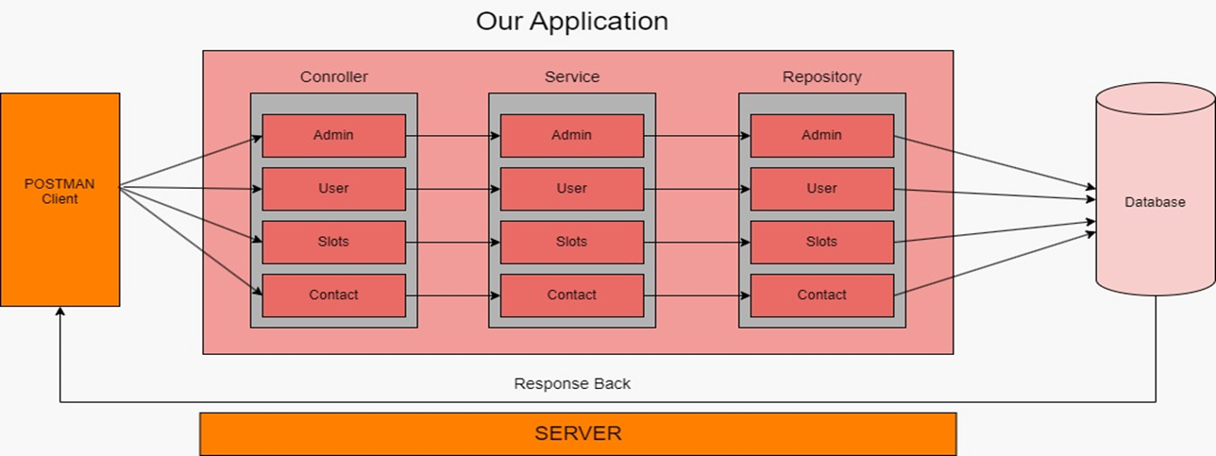
DATA FLOW OF THE APPLICATION

Slide 9
CHALLENGES AND SOLUTIONS
Challenges
Concurrent Bookings:
Managing multiple users booking the same course slot simultaneously, leading to potential scheduling conflicts.
Database Design and Optimization:
Designing an efficient database structure to handle large volumes of user and course data while ensuring optimal performance.
Solutions
Managing Bookings:
Implemented algorithms to detect and resolve booking conflicts in real-time.
Added a locking mechanism to prevent overlapping bookings.
Database Optimization:
Optimized database queries and indexing to improve speed and efficiency.
Regularly tested and refined the database design to ensure scalability and reliability.

Slide 10
RESULTS
Prototype Developed: Functional prototype with all core features implemented.
Core Features:
Secure login and registration.
Course management, slot booking, and progress tracking.
Automated email/SMS notifications.
User Interface:
Intuitive design for learners to explore, book, and track courses.
Admin dashboard for efficient management of users and courses.
Impact: Improved user experience, accessibility, and engagement for flexible learning.

Slide 11
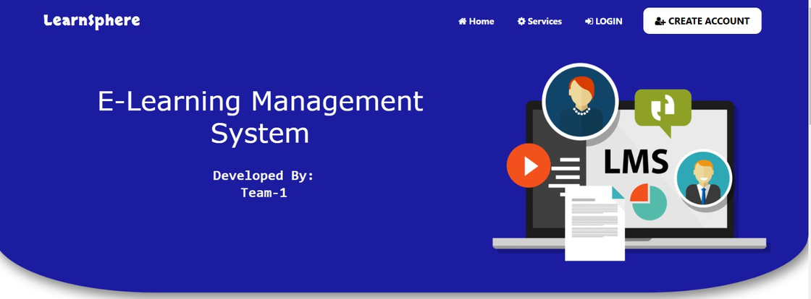
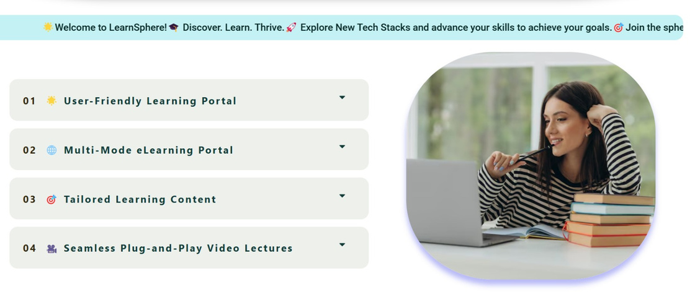
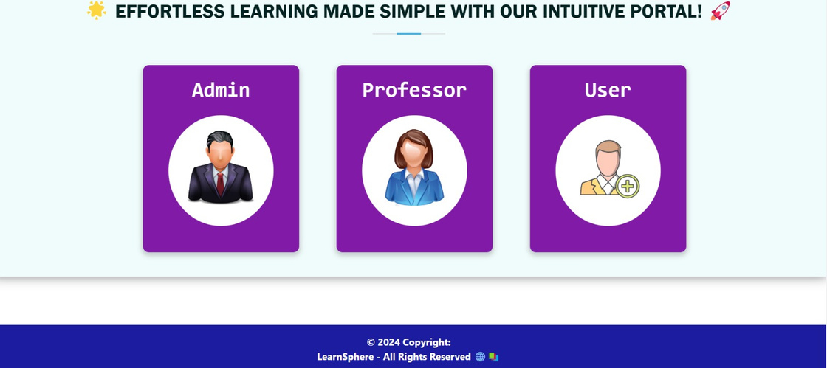
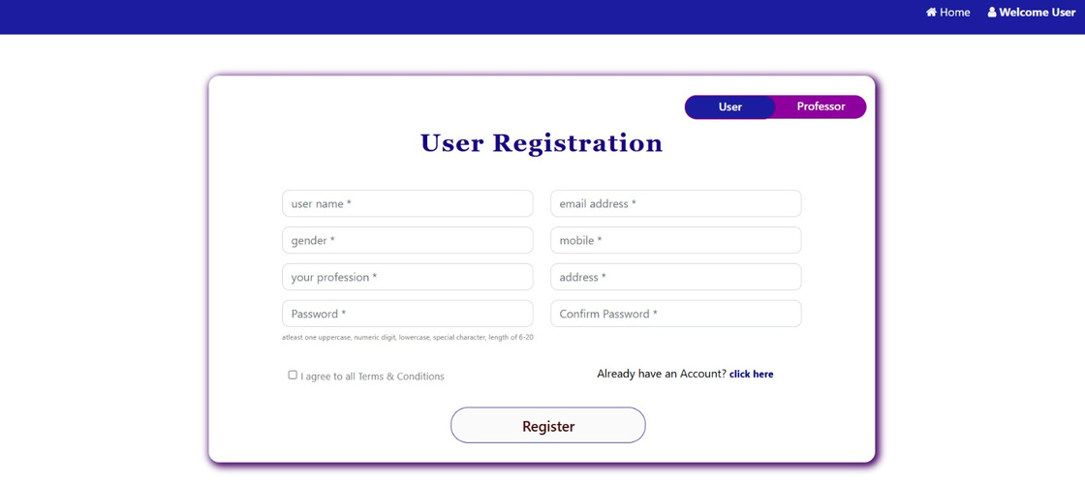
OUTPUT

Slide 12
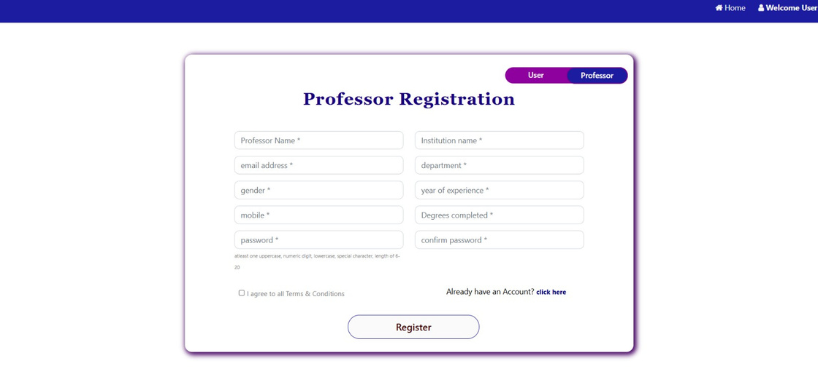
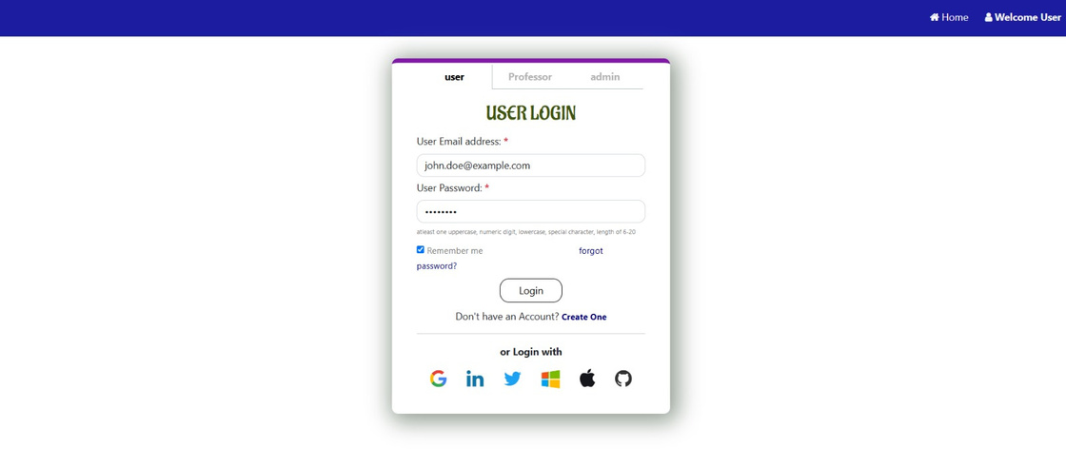
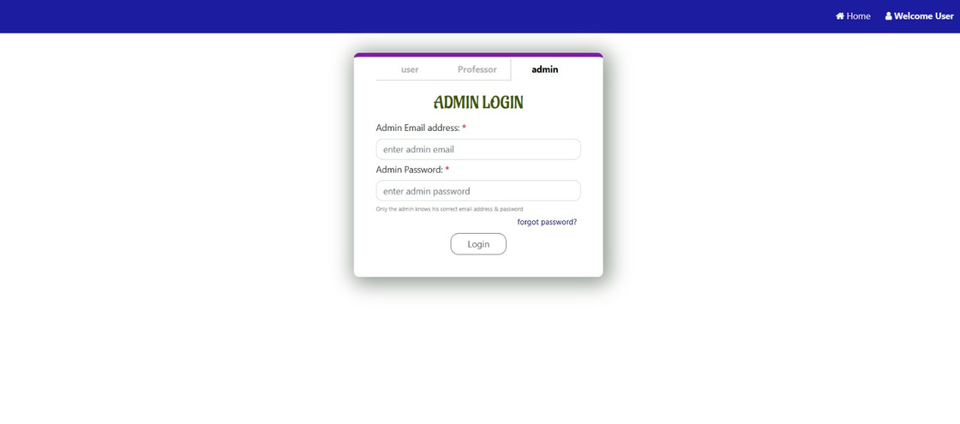

Slide 13
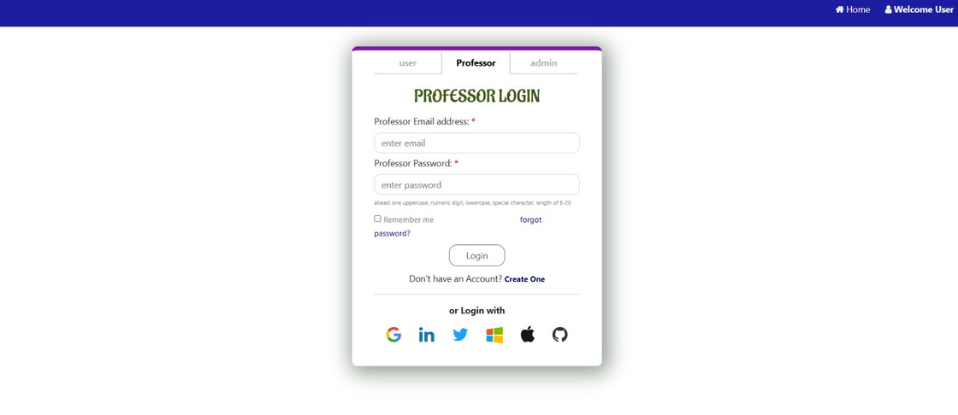
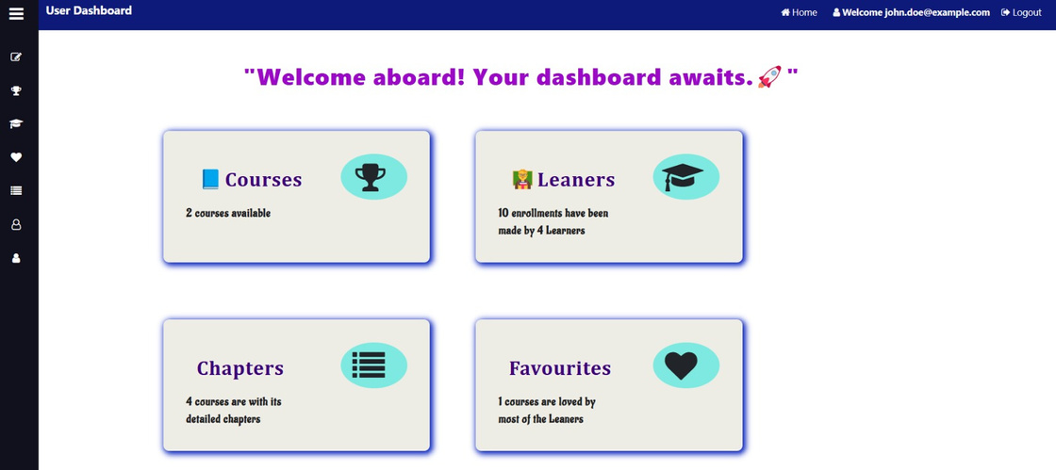
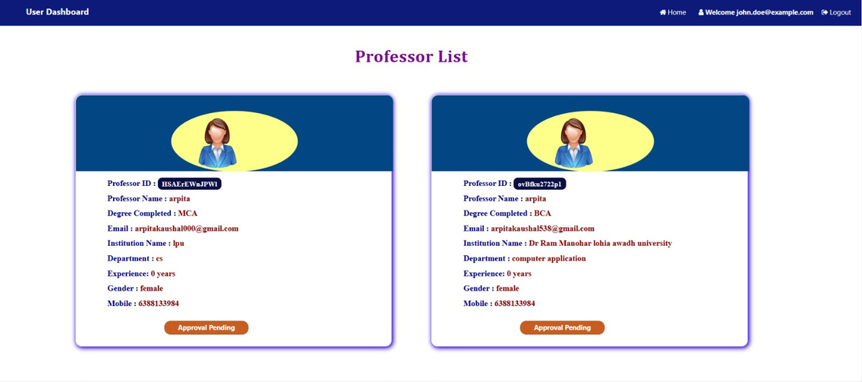
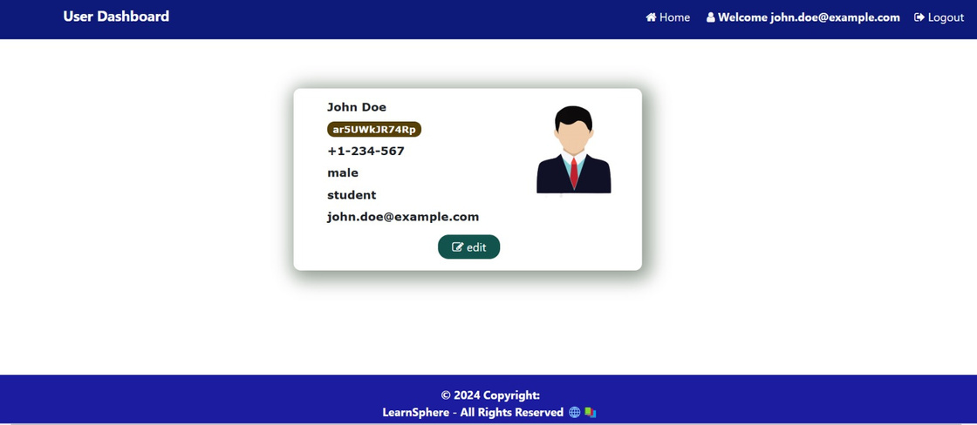

Slide 14
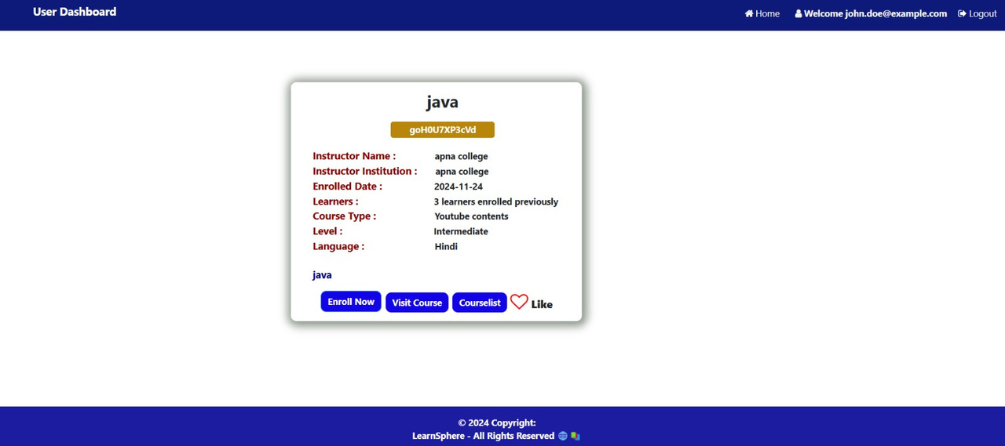
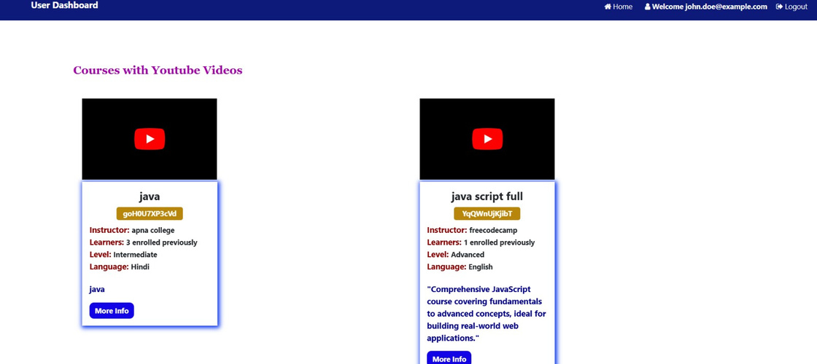
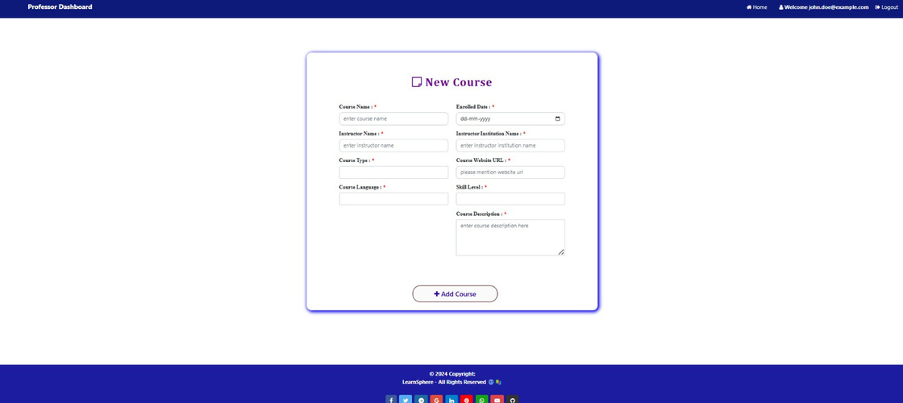
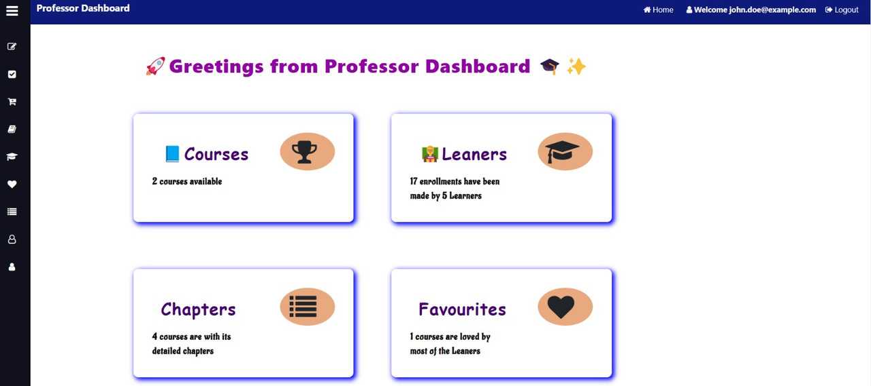

Slide 15
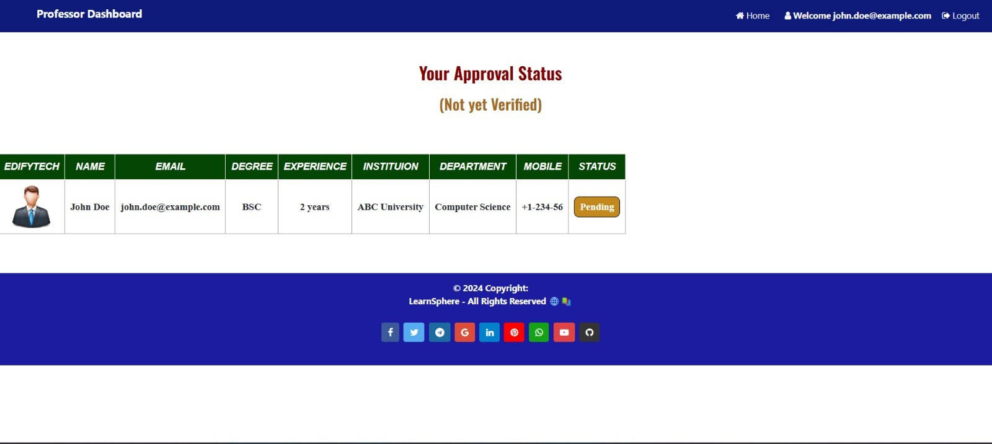

Slide 16
CONCLUSION
The E-Learning System successfully delivers a robust and user-friendly platform that enhances remote learning experiences. It combines secure user authentication, efficient course management, intuitive booking and scheduling, progress tracking, and automated notifications, ensuring a seamless experience for both learners and administrators. The project demonstrates the potential of technology to make education more accessible, flexible, and engaging while laying a strong foundation for future scalability and enhancements.

Slide 17
ACKNOWLEDGEMENT
We would like to express our heartfelt gratitude to our mentor, Mr. Sanjeeva Gone, for providing us with the opportunity to work on this E-Learning System project. His valuable guidance, support, and insights were instrumental in navigating challenges and enhancing our understanding throughout the project. We are deeply thankful for his mentorship and the knowledge he imparted to us.
We also extend our sincere appreciation to our team members for their dedication, hard work, and collaborative spirit. Each member's contributions and commitment were vital in achieving the project objectives and delivering a successful outcome. The teamwork and mutual support made this journey both productive and fulfilling.

Slide 18
THANK YOU

